Slide 1
Using Food Webs to Evaluate Restoration
Treatments in Salmon Producing Streams
John Jorgensen
Yakama Nation Fisheries Resource
PhD Student WSU School of the Environment
Must View in slide show in order to see animations

Slide 2
Todays talk will cover:
Status of Salmon in the Columbia River Basin
Co-Limitation in UC Tributaries
Applying and Evaluating Multiple Restoration Treatments
Food Web Monitoring Methods
Using Food Flow Webs to Prioritize Restoration Actions
Notes:
Quick look at similar applications
The idea of Co-limitation in the tributaries we work in
Quick look at the methods of food webs as evaluation tools, specifically TBP and food flow webs
A brief look at the application of these methods

Slide 3
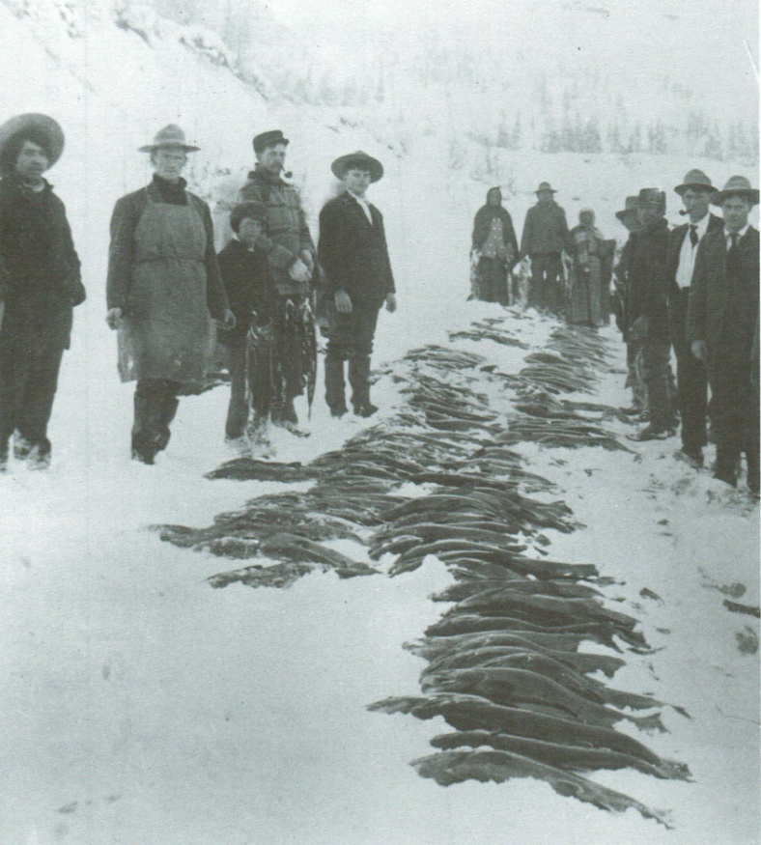
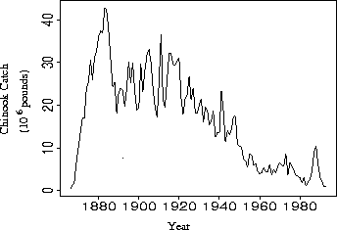
Columbia River Salmon Population Declines
Adult Abundance Estimates
Historical
16-20 Million
Current Estimates
1 Million
80% Hatchery Fish
(NWPC 2001)

Slide 4
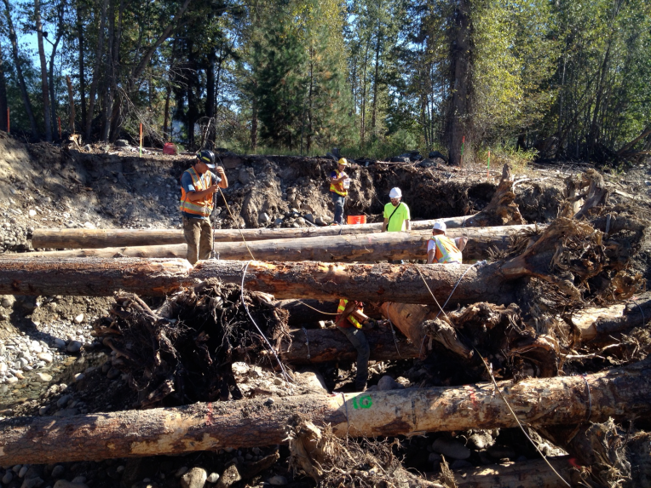
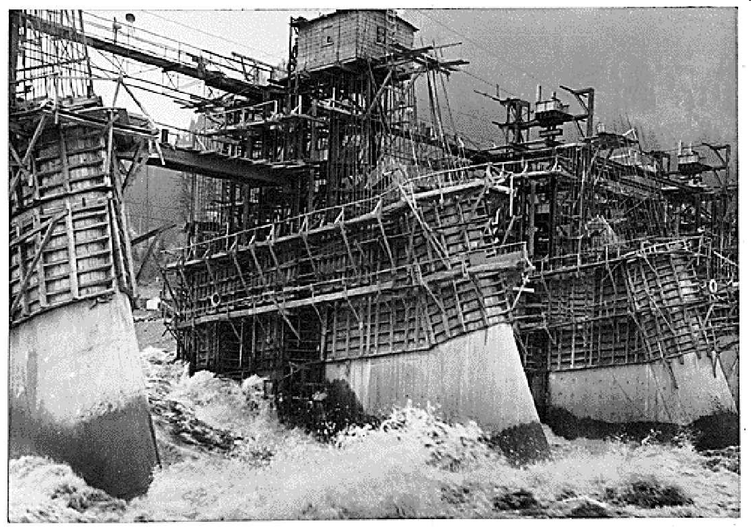
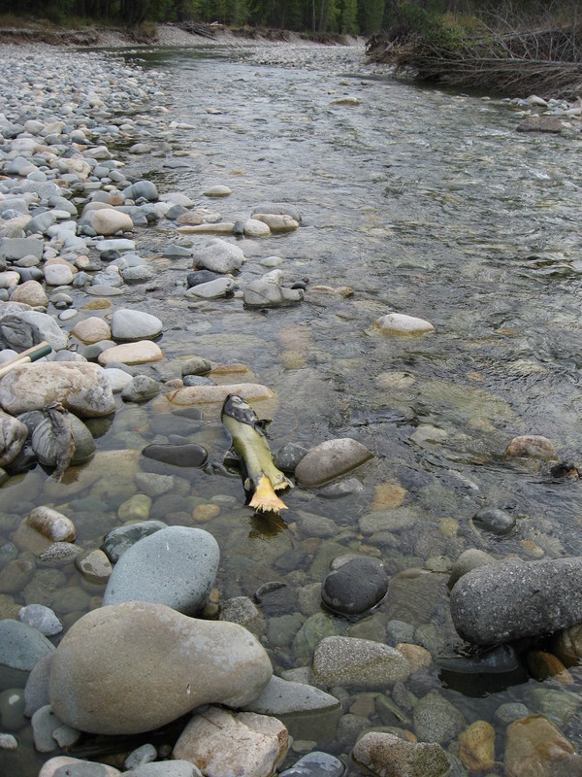
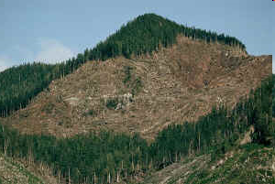
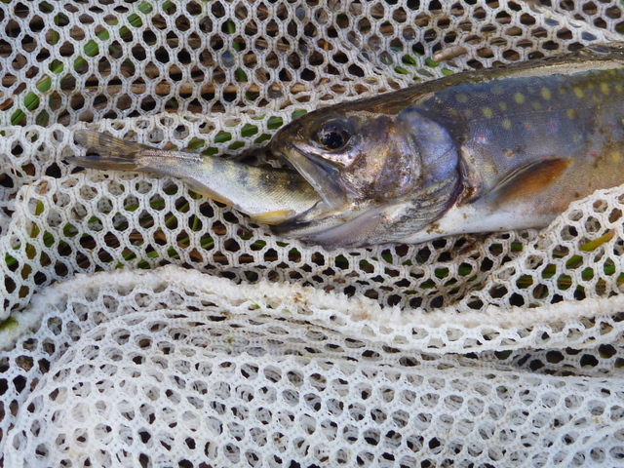
Salmon and Steelhead Population Declines Are Often Due to Cumulative Effects of Many Factors
Notes:
We are all aware of the multitudes of limitations to Threatened and Endangered fish species in UC tribuataries.

Slide 5
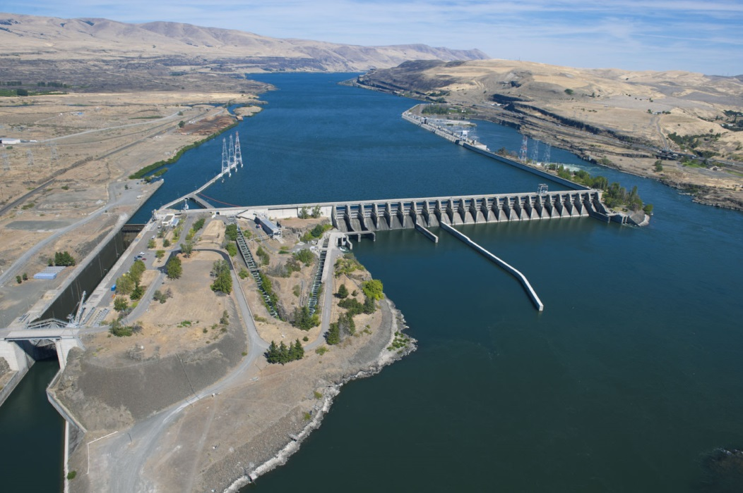
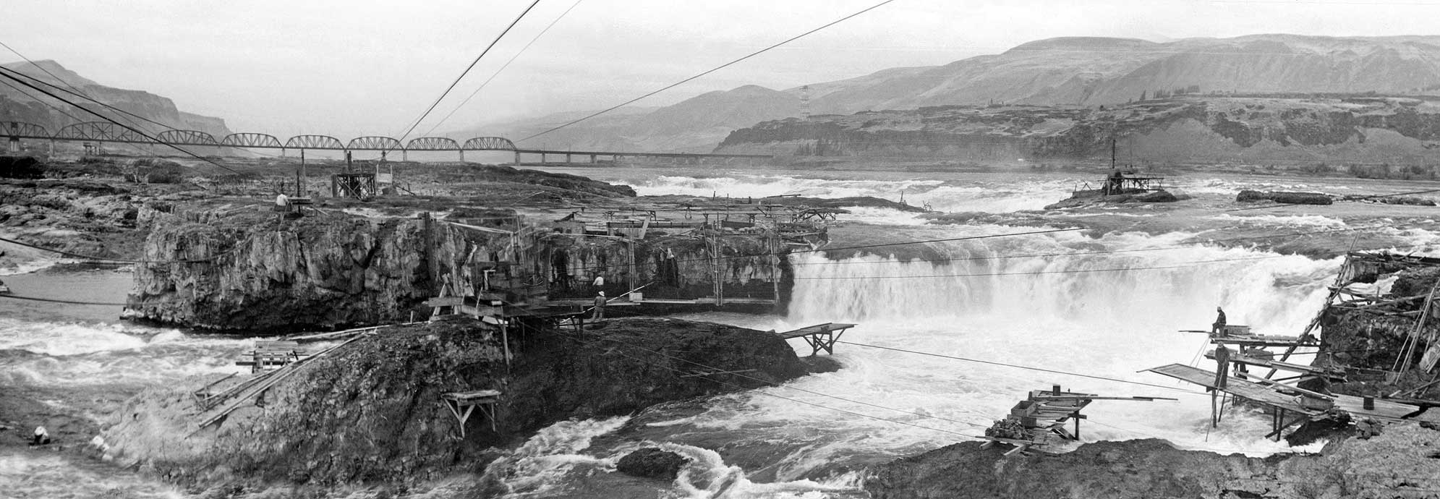

Slide 6
Endangered Species Listing
Multiple stocks (sub-populations) throughout UC (1996)
Hydropower operators mitigated to fund recovery effort (primarily BPA)
Tributary Production is the recovery target

Slide 7
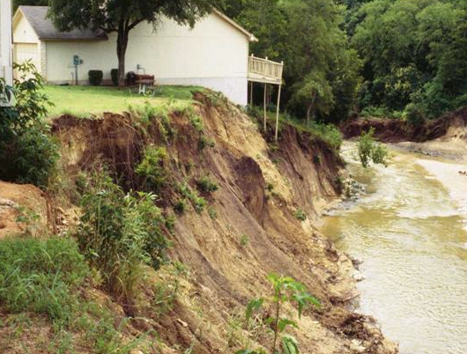
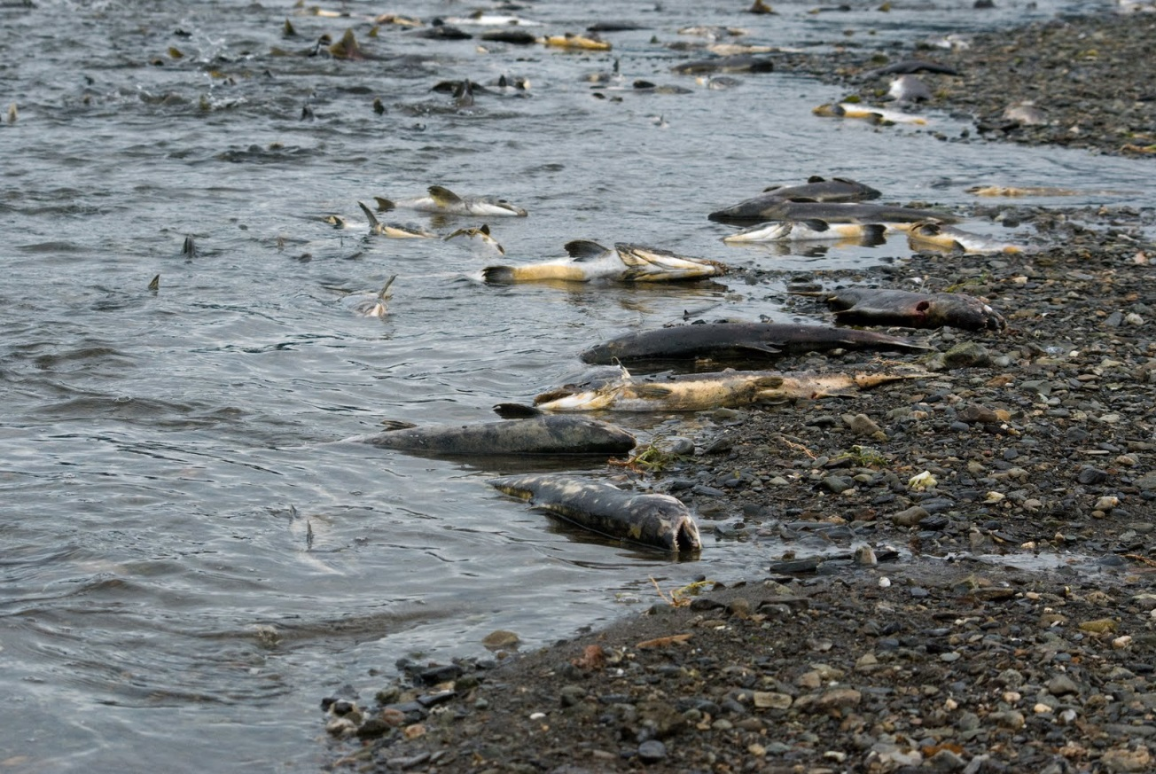

Co-Limitation Tributaries
Channel Degradation
Loss of MDN
Notes:
Most of us are aware of the need to address degradation as part of in-channel specific restoration. These degradations are generally a result of flood plain alteration and consist of physical actions aimed at restoring hydraulic function.
Though it is much harder to see the effects of MDN loss as most of us have never seen tributaries with healthy contributions of carcasses

Slide 8
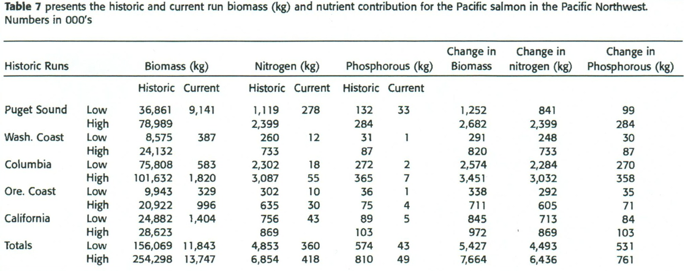
MDN Reductions
Gresh et al. 2000
Notes:
Results of reduced adult escapement shows that even in low years there is a significant effect which we can also see in drastically reduced levels of N and P.

Slide 9
Co-Limitation
Loss of Channel Complexity
Loss of MDN
Presence of Non-Natives
(Sanderson et al. 2009)
Notes:
Most of us are aware of the need to address degradation as part of in-channel specific restoration. These degradations are generally a result of gflood plain alteration and consist of physical actions aimed at restoring hydraulic function.
A paper in Bioscience by Beth Sanderson shows the distribution of non natives in the PNW with shaded areas indicating where invasive compete with listed fish species.

Slide 10
Question: Are there increased benefits to ESA listed fish from applying additive restoration treatments within
the same reach?
Historic Production
Restoration Treatment
Target Production
Removal of Non-Natives
Question: Can we quantify the separate as well as combined effects of these restoration treatments to fish production?
Nutrient Addition
Channel Complexity
Current Production
Notes:
How to we restore these UC tributaries to meet recovery goals.
This could be any number of limitation identified with in a certain watershed

Slide 11
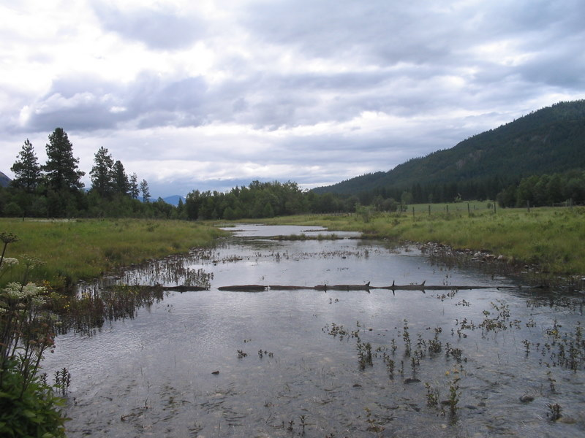
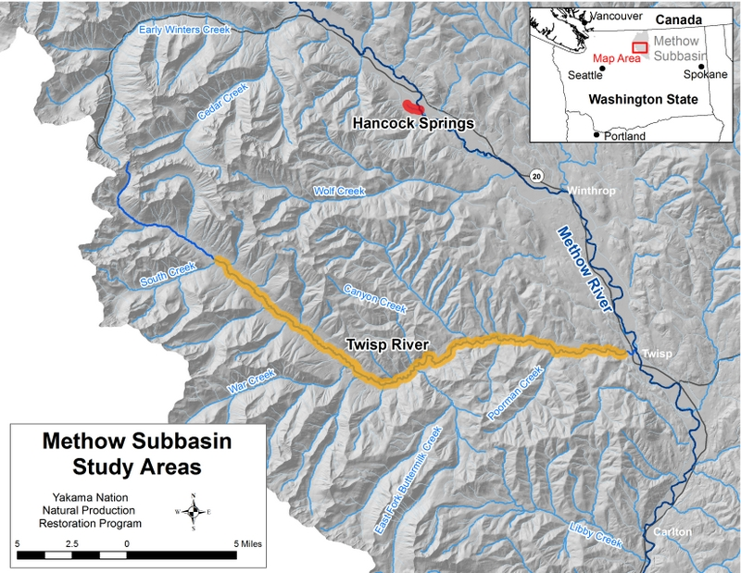
Application: Hancock Springs
Highly Degraded Spring Creek
Loss of complexity
Missing MDN
Presence of Brook Trout
What are separate and additive effects of multiple restoration treatments on fish production?
Notes:
Now that we have looked at the methods let’s go see how the rubber meets the road by applying techniques to a successful restoration project.
Our restoration site is a 1 kilometer long first order spring creek.

Slide 12
Treatment: Schedule
Channel Complexity 2011
Nutrient Enhancement 2014
Invasive Removal (Brook Trout) 2016

Slide 13
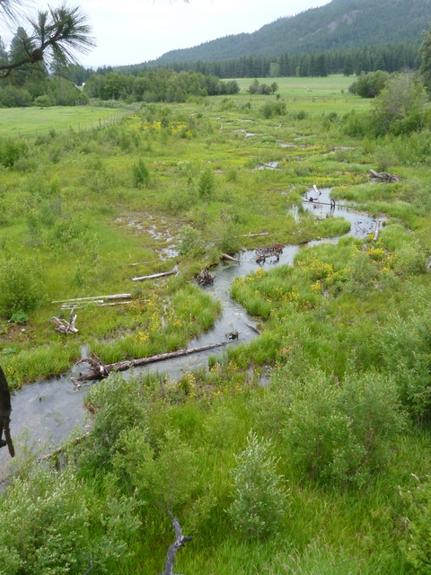
First Treatment
Channel Reconstruction
Notes:
Spring 2012

Slide 14
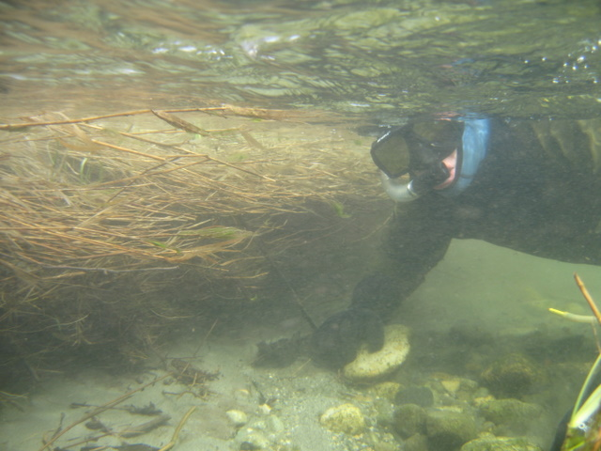
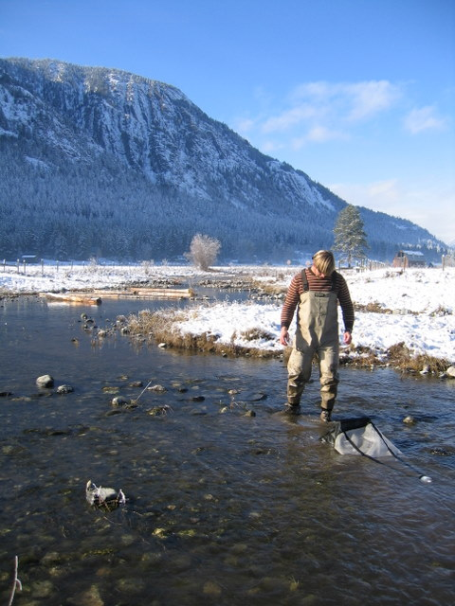
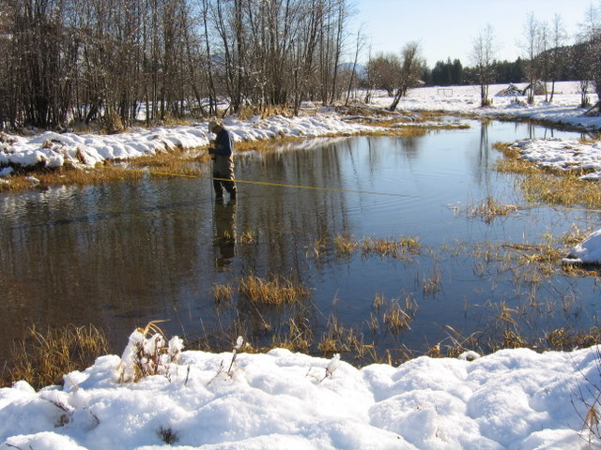
Physical and Biological Assessment
Cross sections
Pebble counts
BMI samples
Temperature
Water quality
Snorkel surveys
Riparian inventory

Slide 15
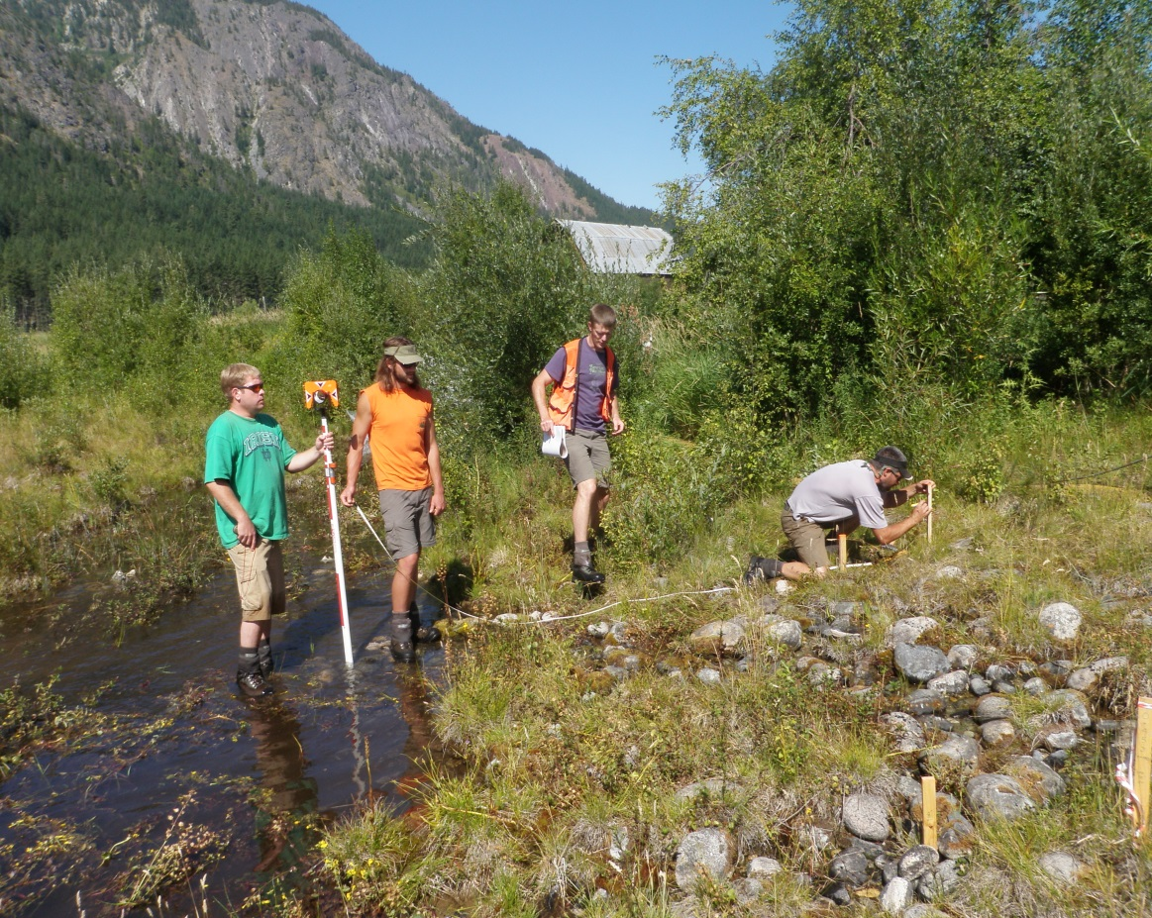
Restoration Design
Goals (Fish)
Reference Reach
Channel Conditions
Riparian Diversity

Slide 16
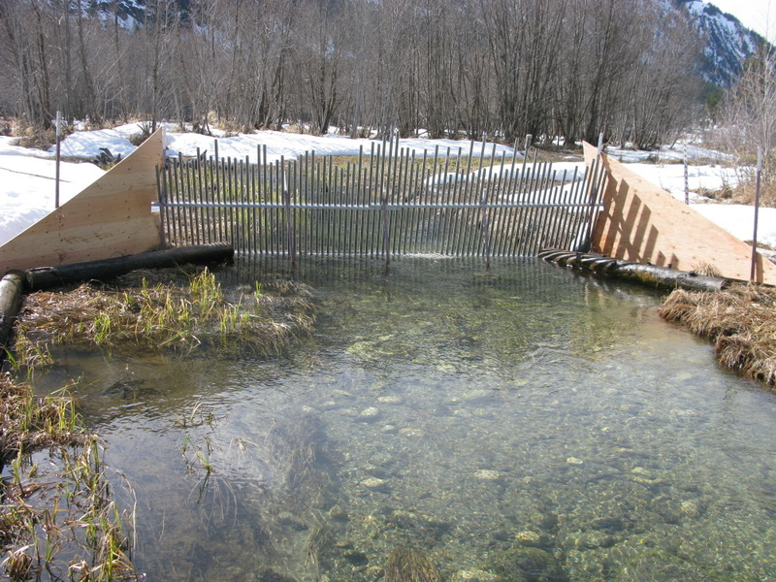
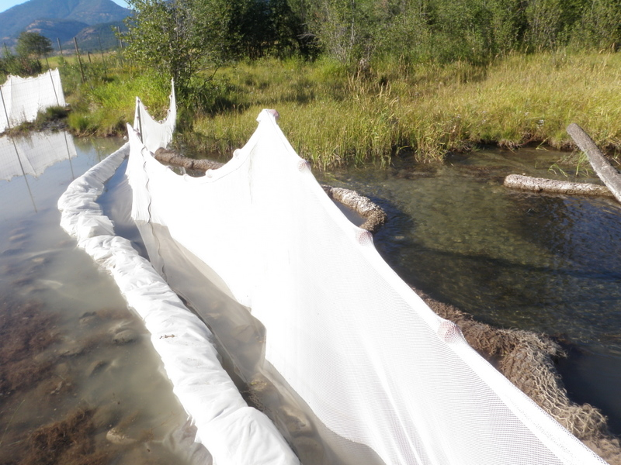
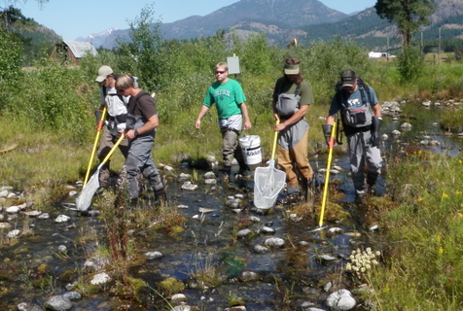
Permits
ESA
County
State
Fish Handling

Slide 17
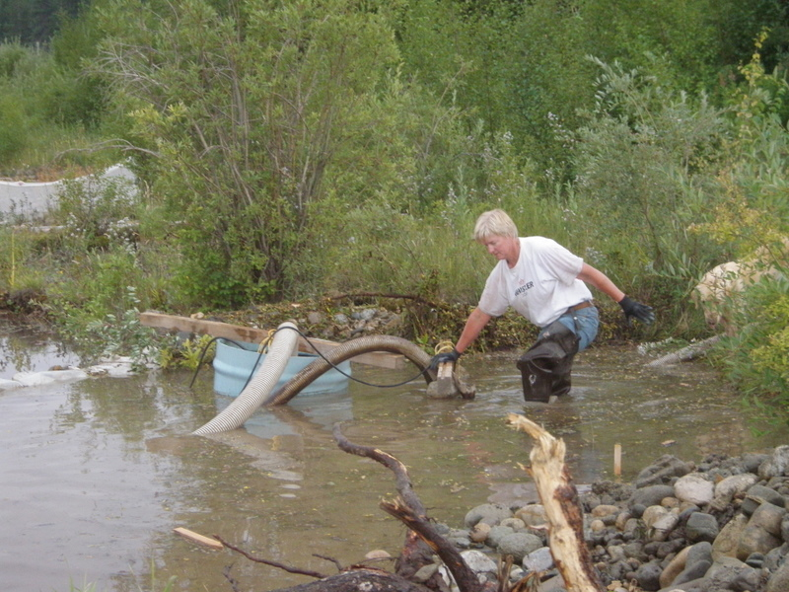
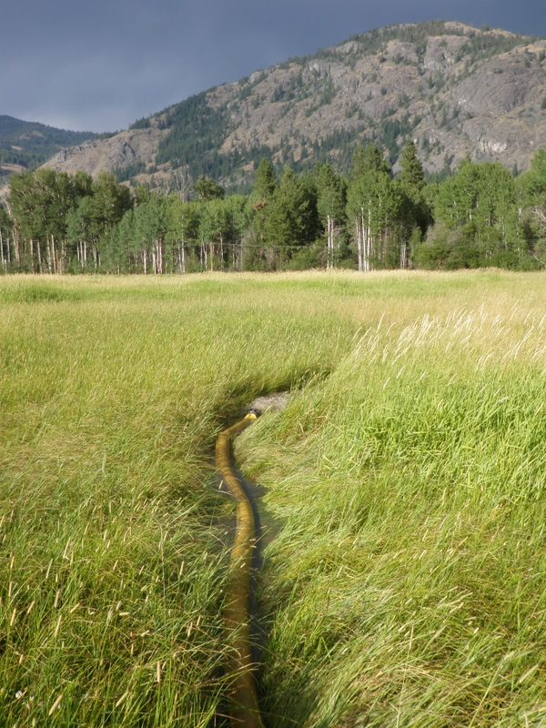
De-Watering

Slide 18
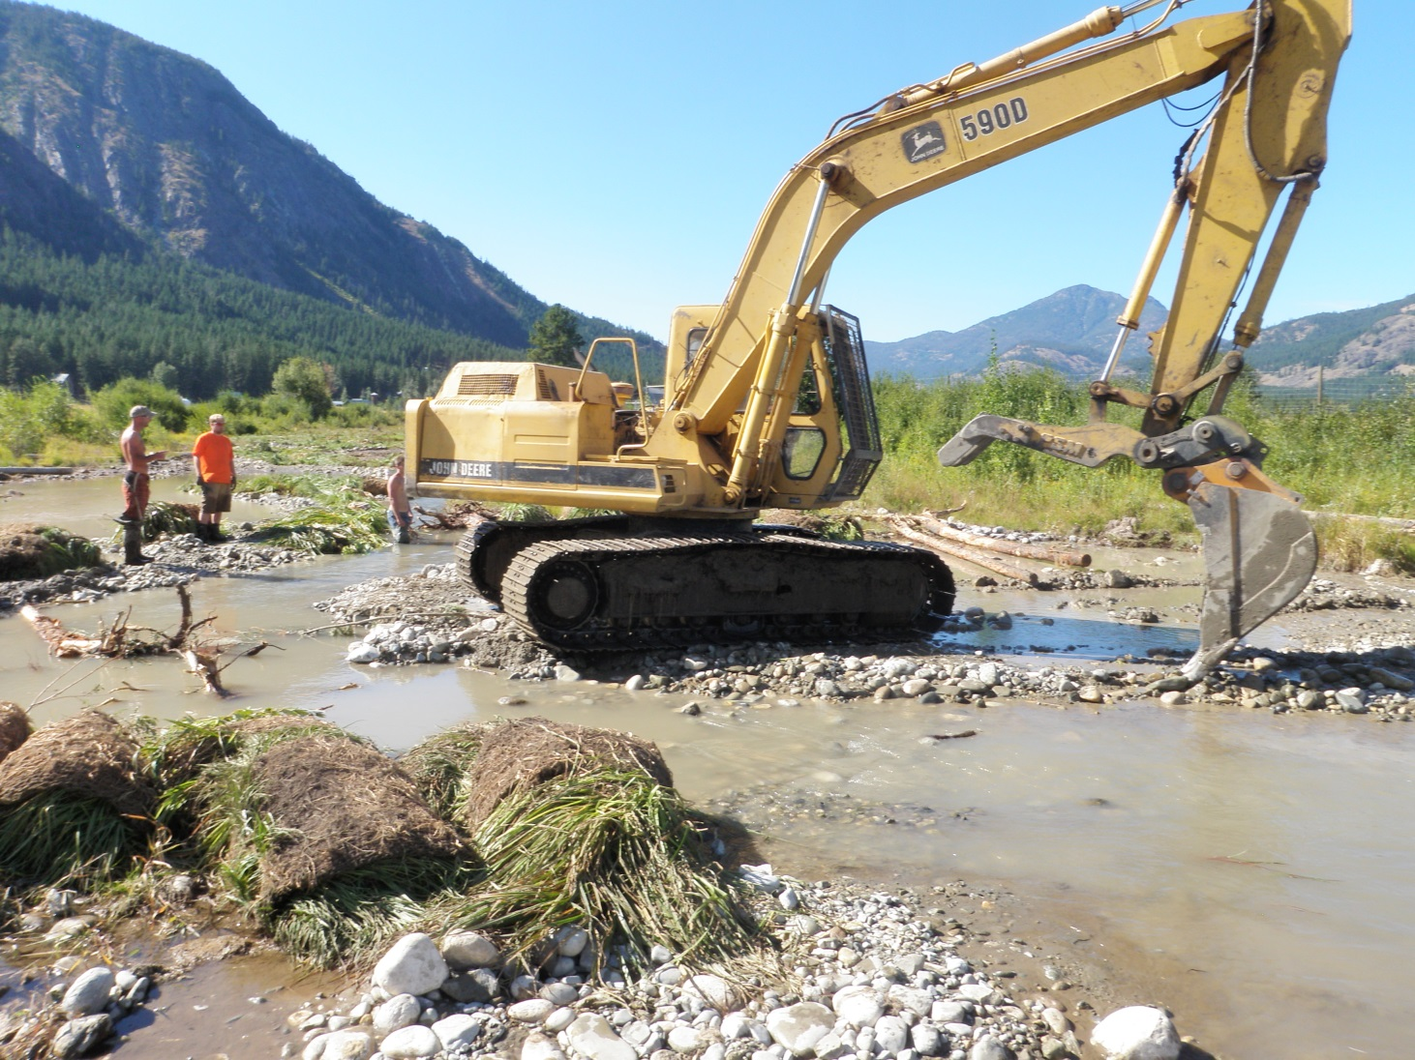
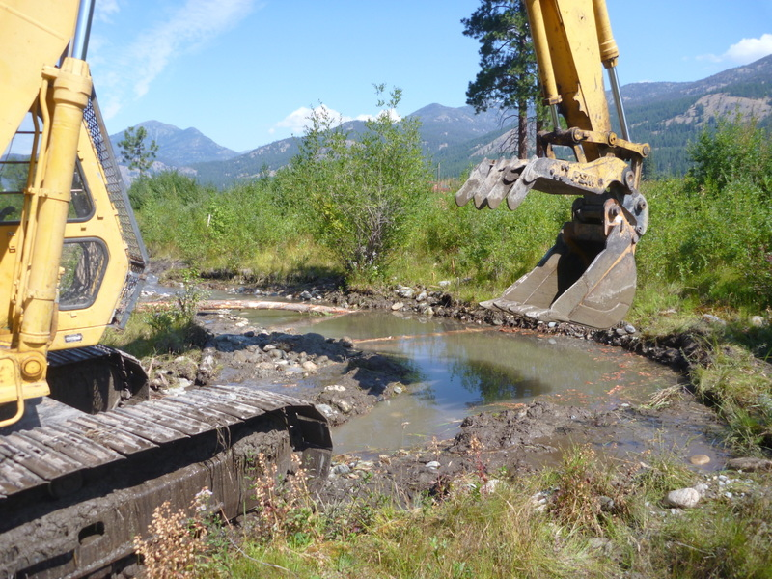
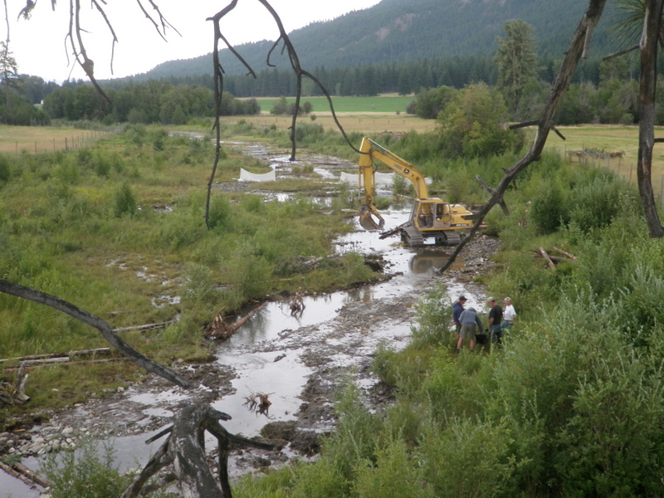
Channel Excavation

Slide 19
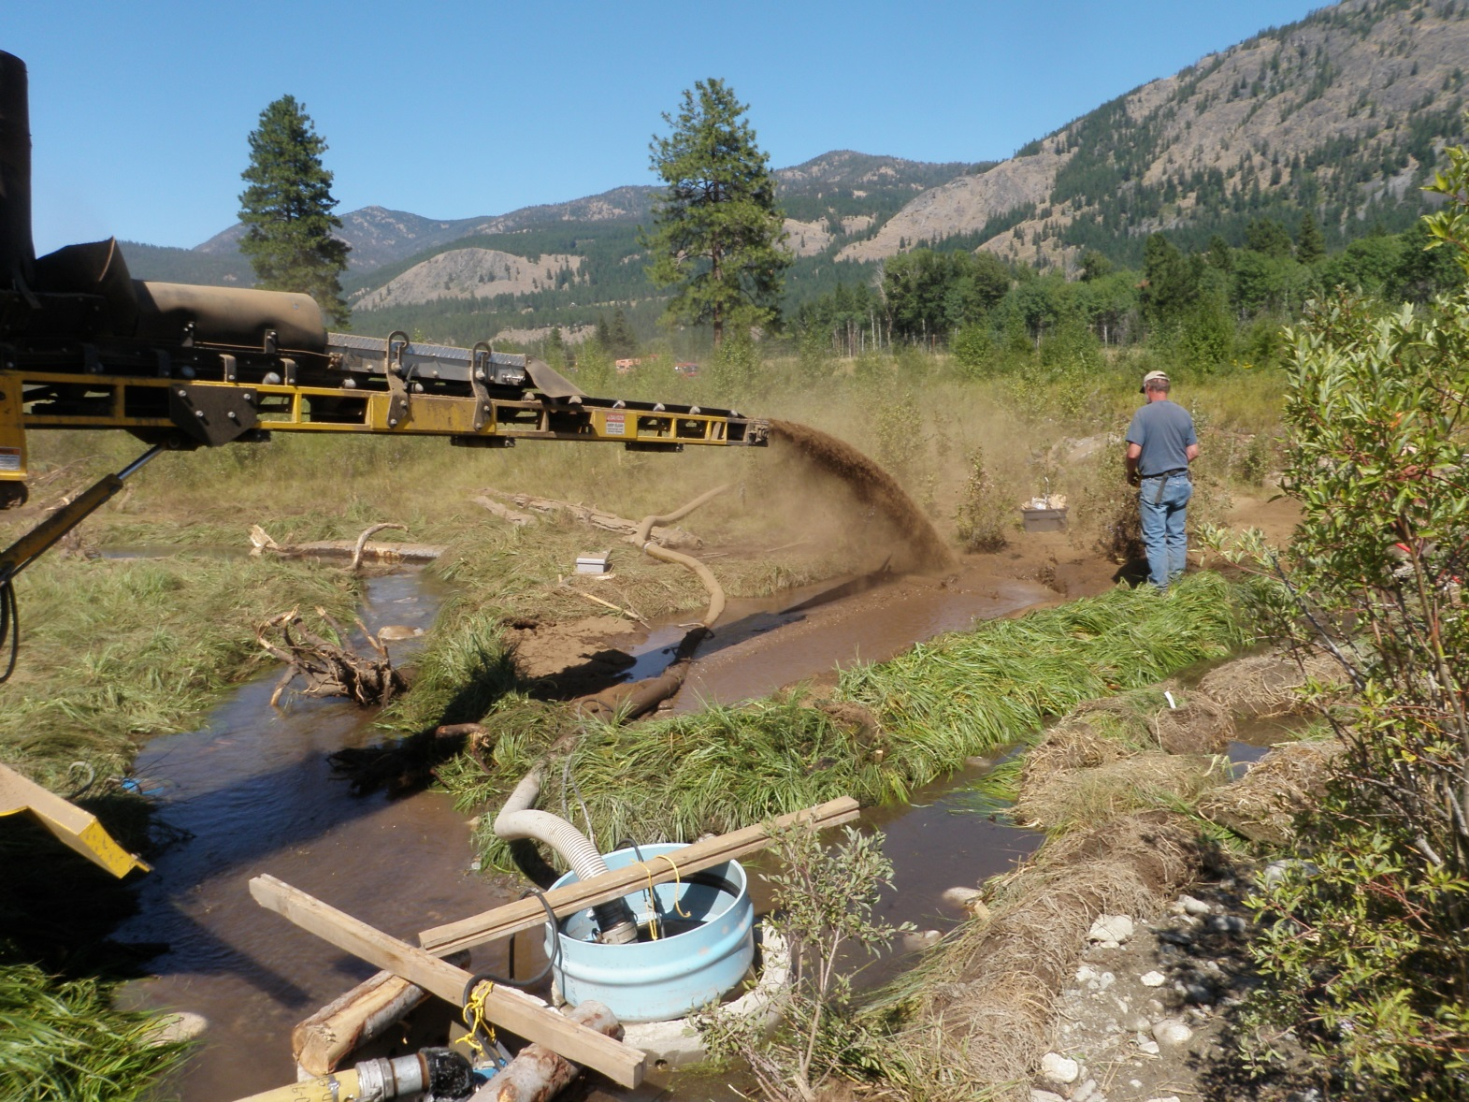
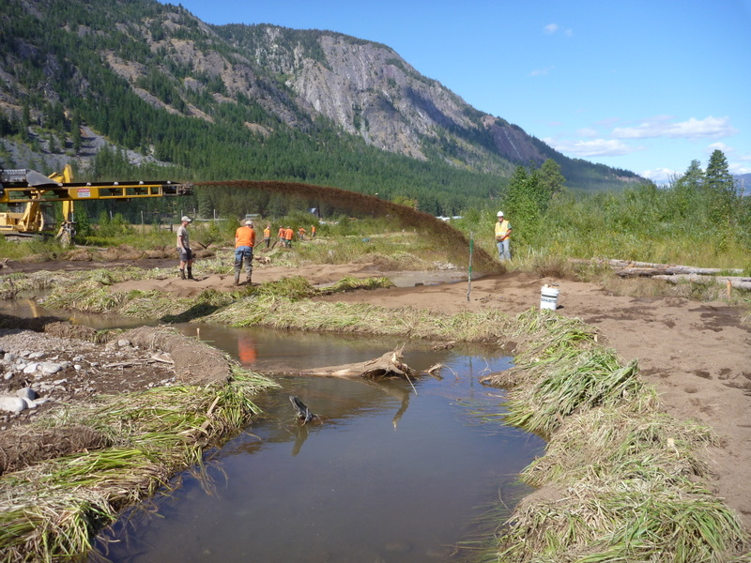
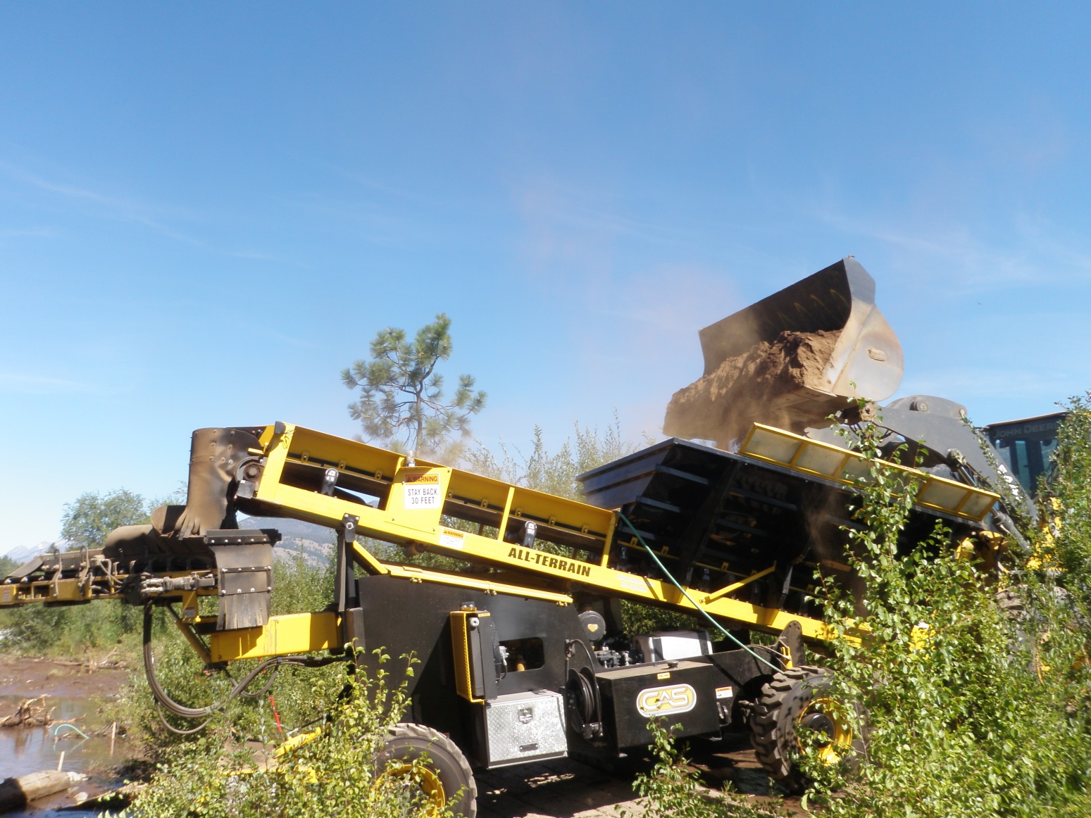
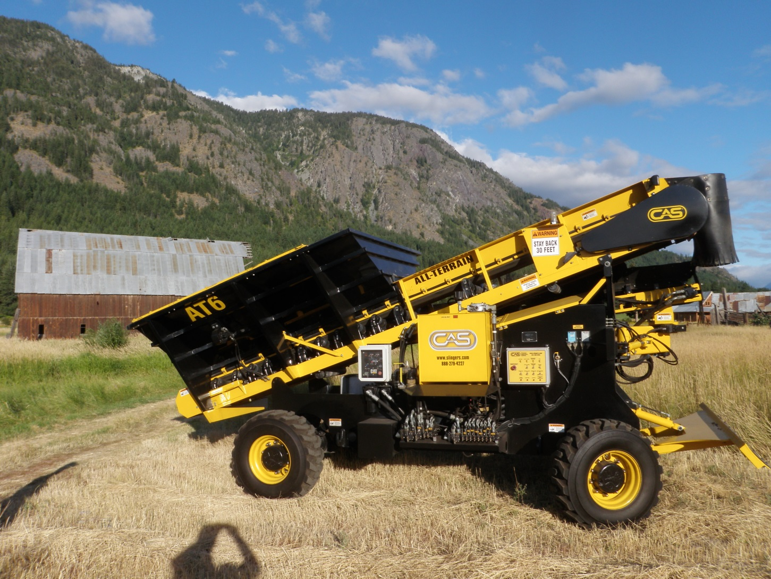
Re-Building Banks

Slide 20
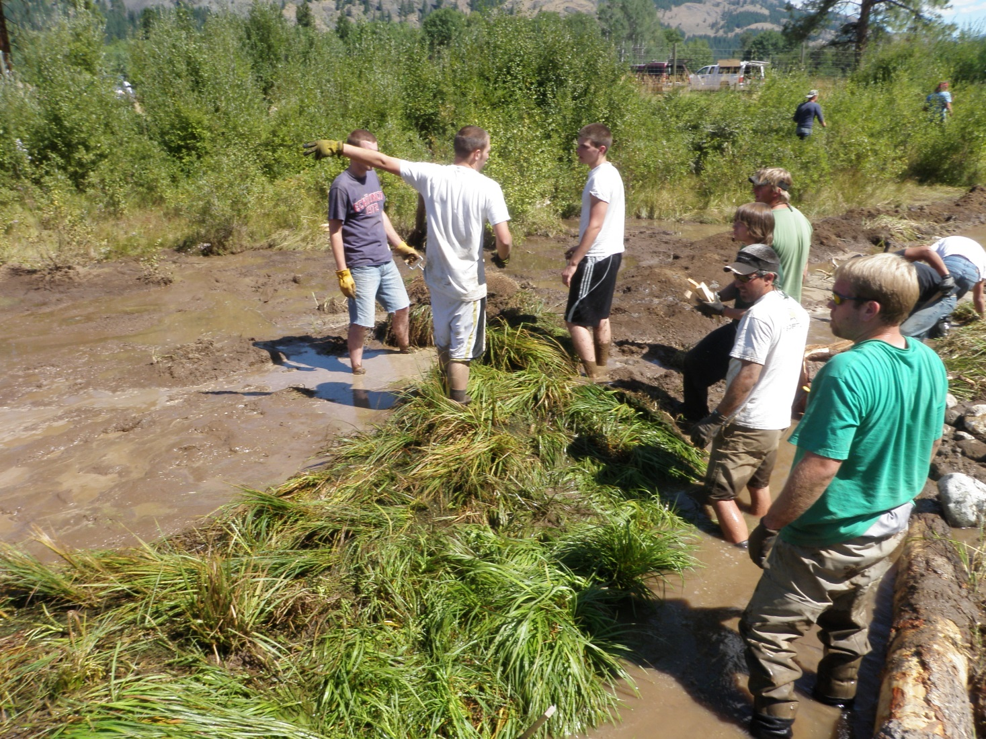
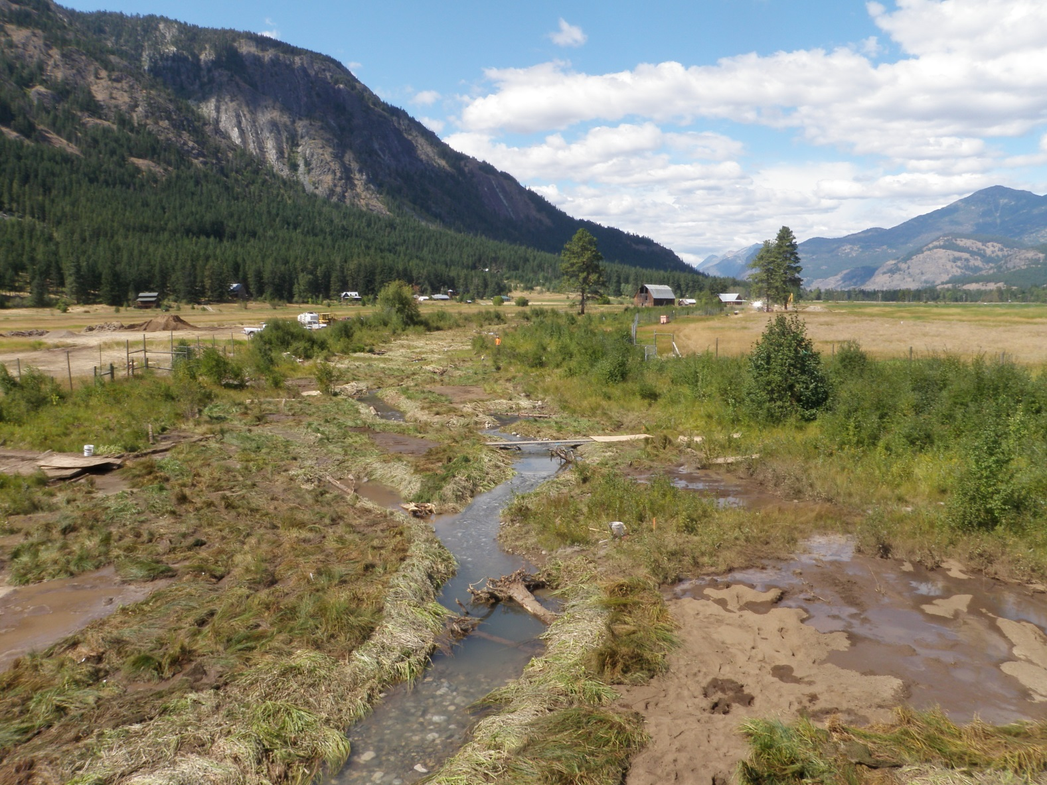
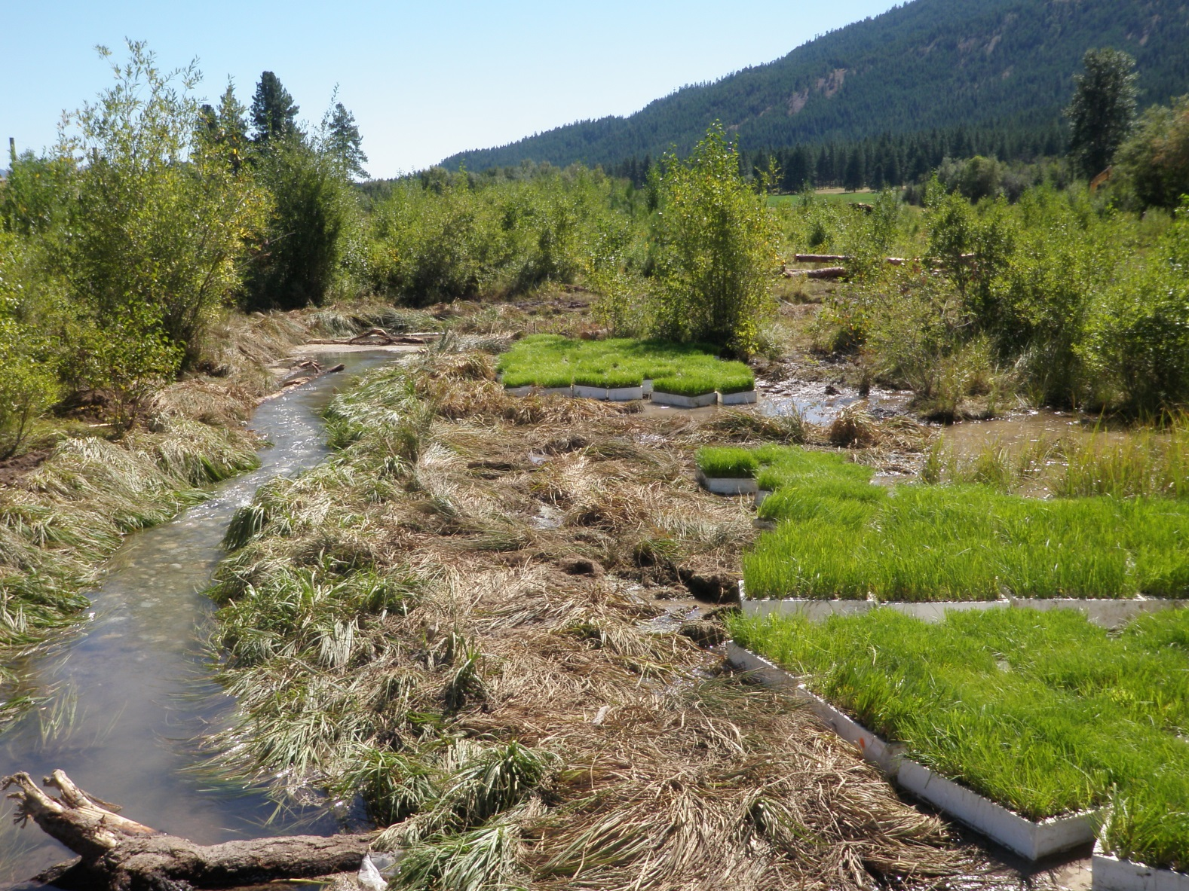
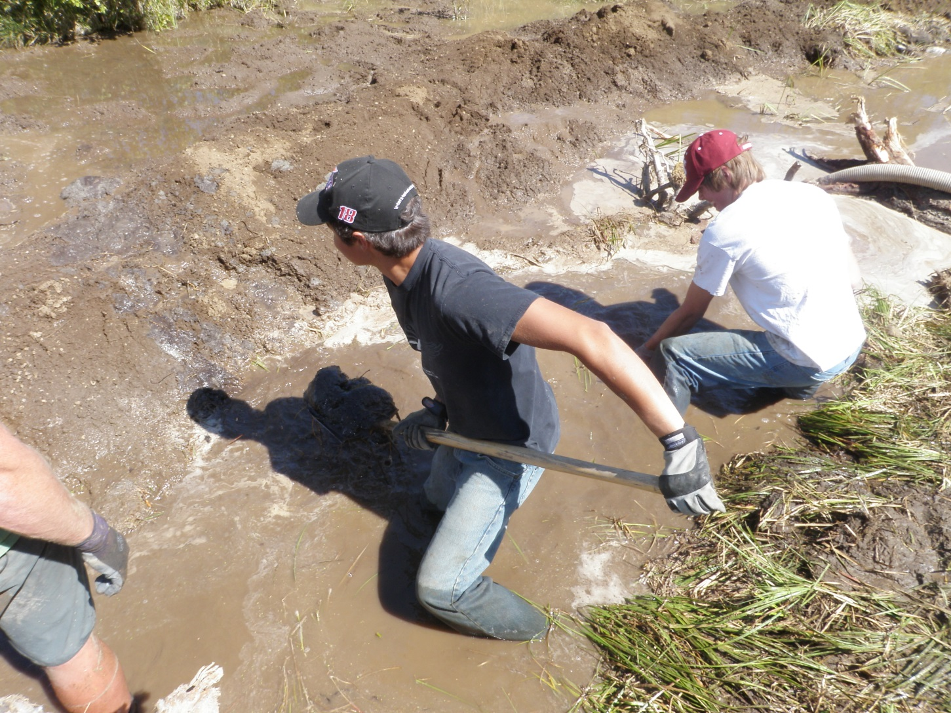
Securing Banks

Slide 21
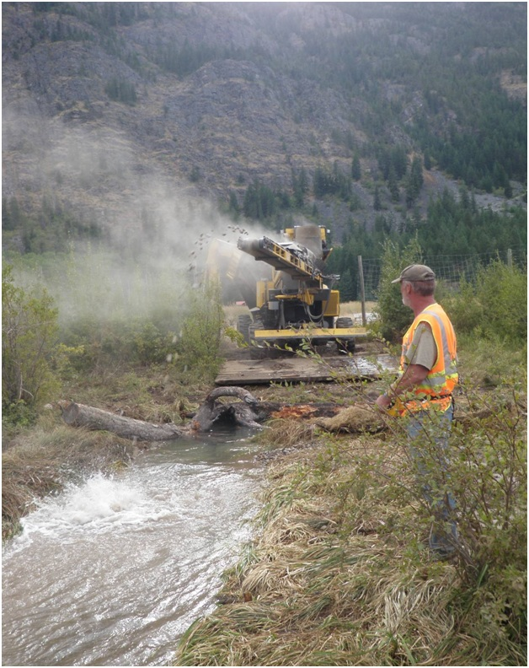
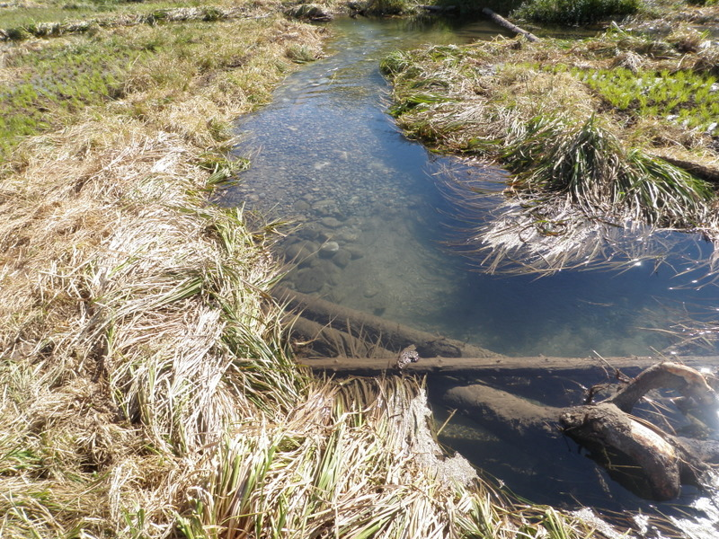
Constructing Riffles

Slide 22
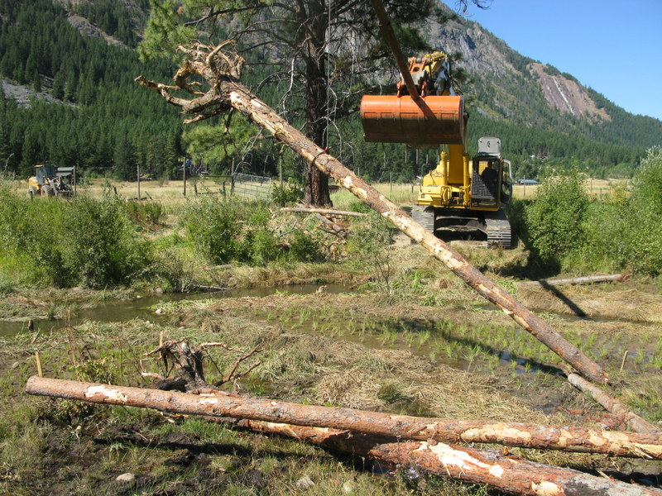
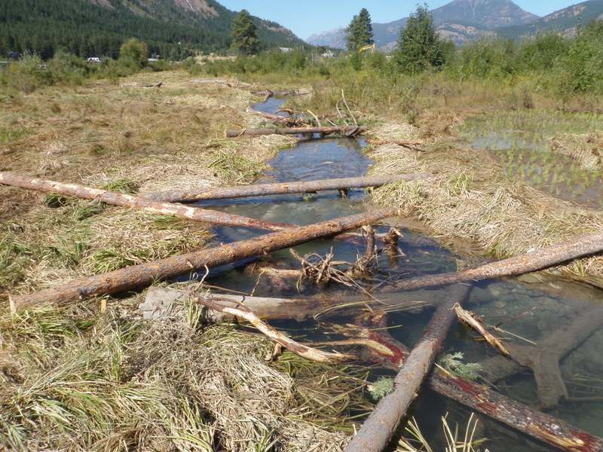
Adding LWD

Slide 23
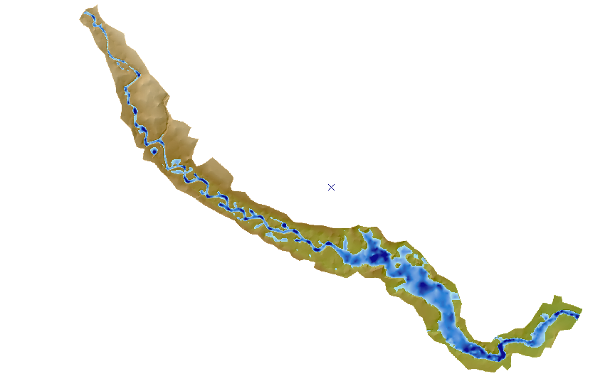
Study Site
Reach 1 (2011 Treatment)
Reach 2 (2011 Control)
Notes:
CHaMP DEM indicating reach breaks for our control and treatment reaches.

Slide 24
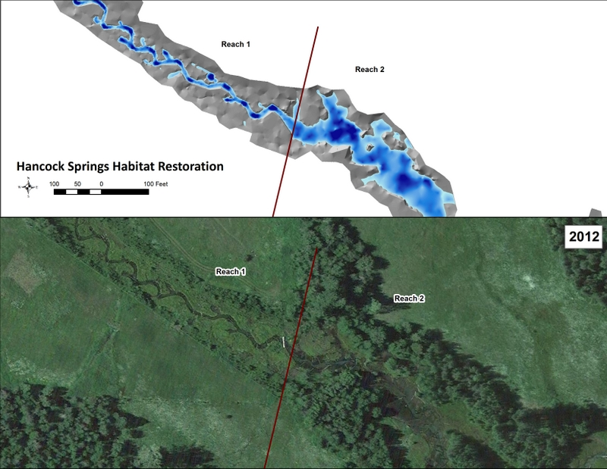
Reach Comparisons
Notes:
Overview of channel conditions at treatment/control reach break

Slide 25

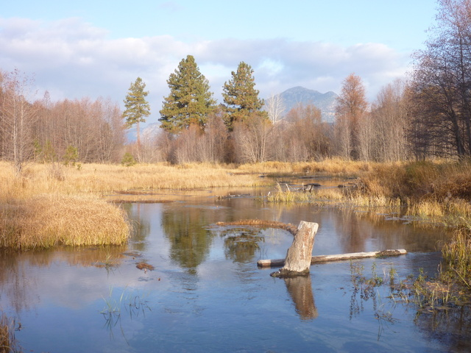
Channel Conditions
Reach 1(2011 Treatment)
Reach 2 (2011 Control)

Slide 26
Spawning Video

Slide 27
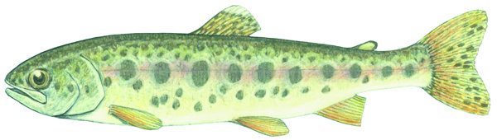
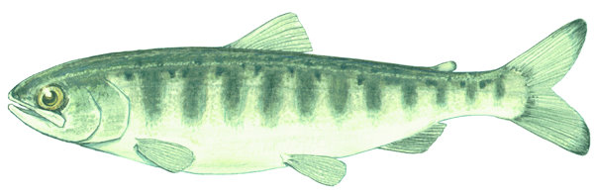
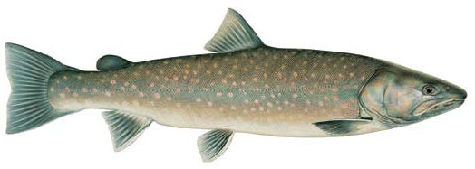
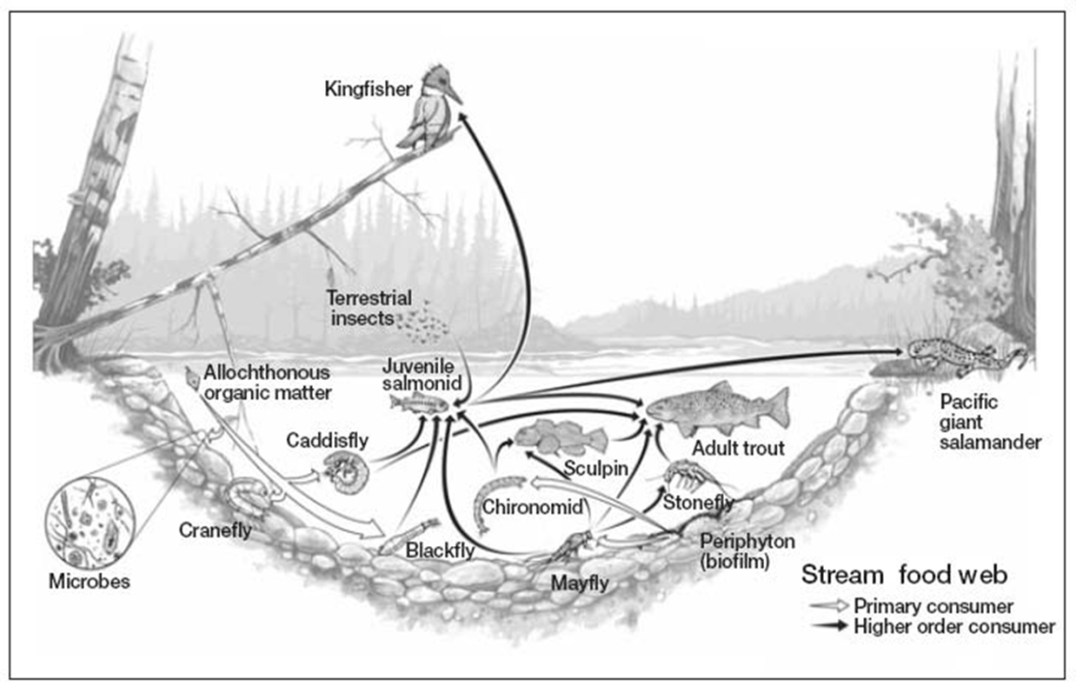
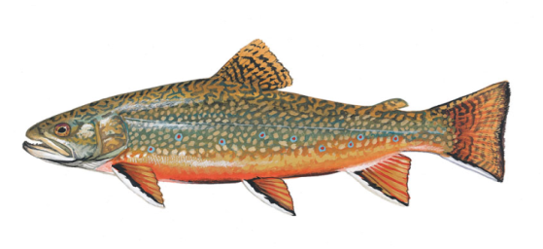
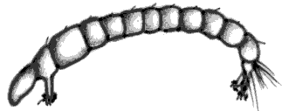

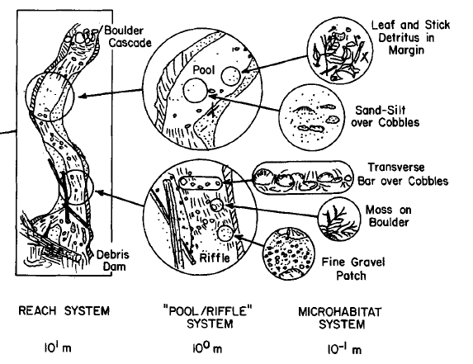
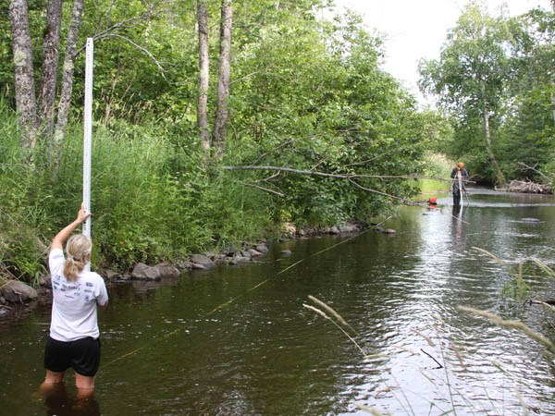


Correlating Fish Production to Habitat Treatments Using Physical Assessments:
Goal: Use an empirical food web analysis in addition to standardized physical habitat assessments (i.e. CHaMP) to understand the mechanisms responsible for specific treatment effects.
Notes:
These assessments are frequently restricted to measurements of the physical habitat template, and/or single species of interest. However, rearing salmon and steelhead also require an adequate food base, which they generally share with numerous other fish species

Slide 28

Linking Fish to Food through Estimates of Secondary Invertebrate Production

Slide 29
We know that food determines the upper bounds of fish production.
Upper Bound
If we quantify food production, we can understand the capacity for different stream habitats to sustain fish.
FISH
PRODUCTION
FOOD PRODUCTION
Notes:
And in reality the capacity to sustain fish production is lower than food production, because some food energy is lost as it is transferred into fish biomass. But this difference is easy to account for as long as we know something about the bioenergetics of the fish, and the quality of the food.
What all this means is that, . . .
if we can quantify food production, we can understand the capacity for different stream habitats, river segments, or entire watershed to sustain fish.

Slide 30
The Energetic Capacity of Streams
FISH
PRODUCTION
FOOD PRODUCTION
Notes:
It also means that as food production changes, the capacity to sustain fishes also changes.
And even though other factors, such as predation and competition, or habitat conditions, may limit fish populations well below this energetic constraint, estimates of food availability still represent a quantitative estimate of stream carrying capacity, and also provides us the basis for conducting ecosystem modeling.
So, the question is how do we appropriately measure food production for stream fishes???

Slide 31




TBP
Quantifying Trophic Productivity Allows For a Better Understanding of Mechanisms Affecting the Food Chain
Notes:
TBP enables us to quantify availability energy at each trophic level which allows us to understand where that energy is limited.
This is estimated of m2 values of dry mass

Slide 32
TBP

Slide 33





Methods For Measuring Secondary (Insects) and Fish Production
Abundance and Biomass = single point in time (g DM m⁻²)
PRODUCTION = accrual of tissue over time
Biomass (g/m²) * Growth Rate (1/year)
(g DM m⁻² y⁻¹)
Fish production
Invertebrate Food Base Production
Notes:
Need to add notes

Slide 34

Results
Associated With The Habitat Treatment
Effects of Non-Natives in Restored Habitat

Slide 35
Study Site
Reach 1 (2011 Treatment)
Reach 2 (2011 Control)
Notes:
CHaMP DEM indicating reach breaks for our control and treatment reaches.

Slide 36


Physical Metrics

Slide 37
Notes:
Blue is reach 1 and red is reach 2, Bull trout only in reach 1

Slide 41
Production Versus Consumption
Notes:
Reach 1 tack food resources

Slide 42

Methods: Diet Sampling
+
Demand for each
prey item by each
fish species
Fish Production
Assimilation & Production
Efficiencies
Notes:
Need to add notes
Proportion of diet items combined with assimilation effeciencies and Net production effeciencies allows us to calculate the demand for each prey item by each prey species.
This allowed me to calculate not only the % of prey items in fish diets, but by combining this information with fish production estiamtes, plus prey specific assimilation and production efficiencies I was able to estimate the calculate the proportion of fish production derived from each prey item plus prey specific assimilation and production efficiencies from the liturature, allowed me to calculate the proportion of fish production derived from each prey item.
I then using these same assimilation and production efficiencies, I back calculated the annual demand for each prey item by each fish species within each habitat type. In other words, the amount of that prey type consumed on an annual basis.

Slide 43



Reach 1(2011Treatment)
Current
Chinook: 9%
Steelhead: 23%
Bull Trout: 3%
Brook Trout: 60%
Sculpin: 5%
Terrestrial
Invert
Perlidae
Chironomidae
Limnephilidae
Hydrophilidae
Ephemerellidae
Other
Gammaridae
Baetidae
Dytiscidae
Tipulidae
Notes:
Sculpin diets still being processed, Brook trout consuming 60% of prey biomass

Slide 44
Reach 2 (Control)
Current
Chinook: 7%
Steelhead: 8%
Brook Trout: 80%
Sculpin: 5%
Rhyacophilidae
Terrestrial
Invert
Chironomidae
Limnephilidae
Ephemerellidae
Hydroptilidae
Other
Gammaridae
Baetidae
Dytiscidae
Tipulidae
Notes:
Need to add notes
This information allowed me to construct flow food webs for each habitat type. This flow food web is for the main channel, and shows the amount of organic matter flowing from each of these prey items to each member of the fish assemblage, which in the main channel included. . .
The width of the arrows represents the amount of organic matter flowing along a particular pathway.
There is a lot going on in this figure, but what I want you to see is two things. First, that all members of the fish assemblage are consuming similar prey items, including target chinook and steelhead, and other non-target species. And Two, the largest organic matter flows are actually flowing toward sculpin and whitefish. Which reflects the larger production of these species in the main channel.

Slide 45
Competition for Food
Prey 2
Prey 3
Potential competition for shared food resources

Slide 46
Reach 1(Treatment)
Predicted Impact of Brook Trout Removal (Proposed 2016)
Chinook: 30%
Steelhead: 43%
Bull Trout: 7%
Brook Trout: 15%
Sculpin: 8%
Terrestrial
Invert
Perlidae
Chironomidae
Limnephilidae
Hydrophilidae
Ephemerellidae
Other
Gammaridae
Baetidae
Dytiscidae
Tipulidae
Notes:
Sculpin diets still being processed

Slide 47

Non-native Removal
Prey 2
Prey 3
Insect consumption by Brook Trout reduced from 9.5g DM/m²/yr to 2.5g DM/m²/yr. Consumption by natives increased by 7.2g DM/m²/yr.
This represents almost half of available prey resources
Notes:
Need to add notes
This information allowed me to calculate quantitative
In addition to this, I also utilized a food web approach. However, in contrast to common connectance food webs, such as the one presented here.Perhaps the simplist and most common food webs are linkage webs, where each of these arrows represented an observed link in the web. Although these types of webs can be quite complex, and are good for visulizing patterns of connectance, they

Slide 48
Summary /Conclusions
Because univariate solutions typically fail to resolve multivariate problems, we need to use multivariate approaches to restoration that directly address specific or suspected limiting factors.
Regardless of which limiting factors are operating in a specific population, food webs provide a useful, integrated approach to characterize conditions and evaluate all restoration treatments.

Slide 49

Questions?
http://yakamafish-nsn.gov/restore/projects/natural-production-restoration-project

